Slide 1
Chongqing University of Technology
ATAI
Advanced Technique of Artificial Intelligence
Chongqing University of Technology
U-BERT: Pre-training User Representations for Improved Recommendation(AAAI_2021)
Zhaopeng Qiu, Xian Wu, Jingyue Gao,Wei Fan
Tencent Medical AI Lab
Peking University
{zhaopengqiu, kevinxwu, davidwfan}@tencent.com, gaojingyue1997@pku.edu.cn
2021.6.4 • ChongQing
Reported by Lele Duan

Slide 2
Chongqing University of Technology
ATAI
Advanced Technique of Artificial Intelligence
Chongqing University of Technology
1.Introduction
2.Method
3.Experiments

Slide 3
Introduction
Chongqing University of Technology
ATAI
Advanced Technique of Artificial Intelligence
Learning user representation is a critical task for recommendation systems as it can encode user preference for personalized services.
However, for less popular domains, the behavior data is insufficient to learn precise user representations.
Inspired by the recent success of BERT in NLP, we propose a novel pretraining and fine-tuning based approach U-BERT.

Slide 4
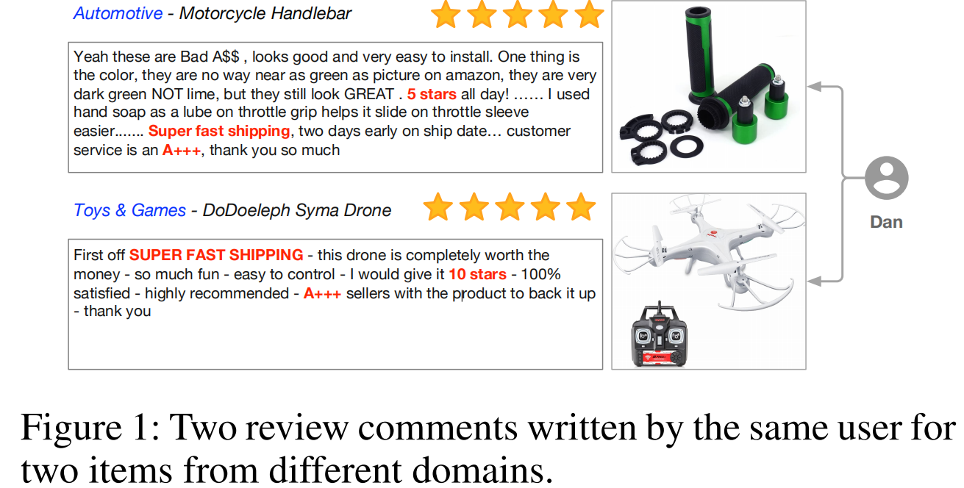
Method
Chongqing University of Technology
ATAI
Advanced Technique of Artificial Intelligence
Problem Formalization
Let and denote the entire user set and item set in the particular domain D, respectively. In this domain, the existing set of reviews written by for is denoted as , in which each review contains a user ID , an item ID , a review text written by , and an overall
rating . The set of reviews generated by U in other different domains is denoted as ,

Slide 5
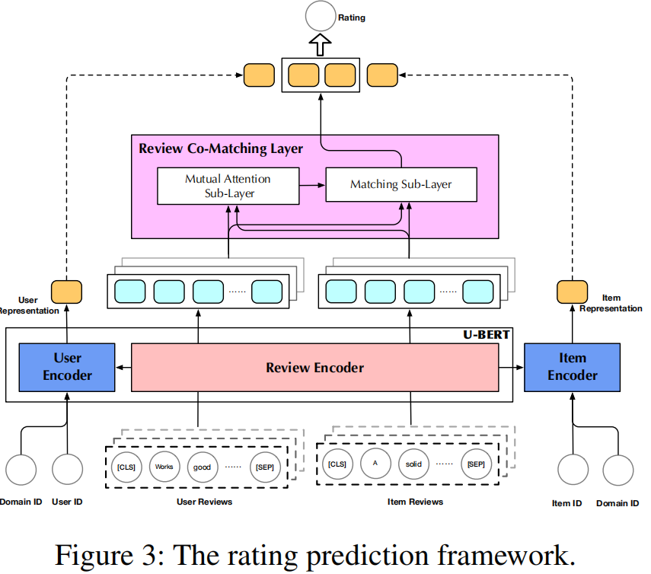
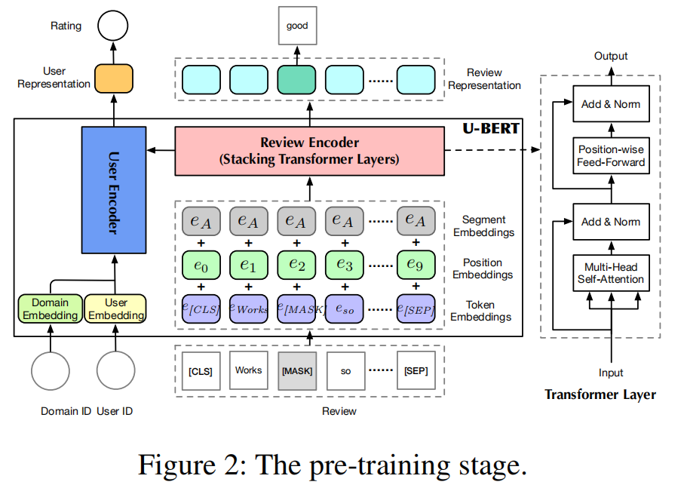
Method
Chongqing University of Technology
ATAI
Advanced Technique of Artificial Intelligence

Slide 6
Method
Chongqing University of Technology
ATAI
Advanced Technique of Artificial Intelligence
Input Layer

Slide 7
Method
Chongqing University of Technology
ATAI
Advanced Technique of Artificial Intelligence
Review Encoder
Multi-Head Self-Attention
Given three input matrices and
where , the attention function is defined as:
Position-wise Feed-Forward
For the input the calculation process of this sub-layer is

Slide 8
Method
Chongqing University of Technology
ATAI
Advanced Technique of Artificial Intelligence
User Encoder

Slide 9
Method
Chongqing University of Technology
ATAI
Advanced Technique of Artificial Intelligence

Slide 10
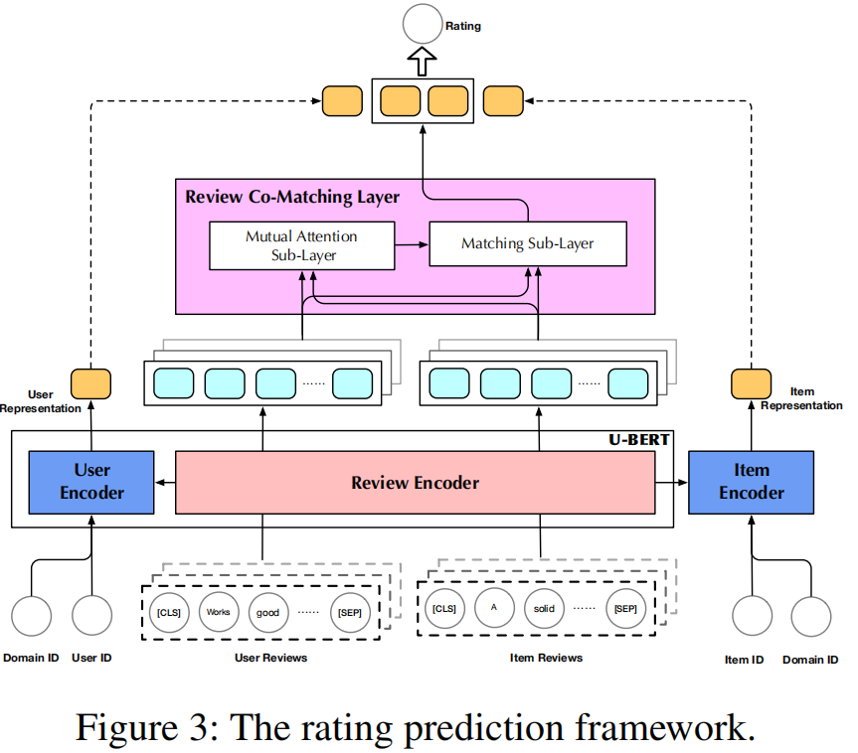
Method
Chongqing University of Technology
ATAI
Advanced Technique of Artificial Intelligence

Slide 11
Method
Chongqing University of Technology
ATAI
Advanced Technique of Artificial Intelligence
Fine-tuning U-BERT for Rating Prediction
Review Co-Matching Layer
①Mutual Attention Sub-Layer：
②Matching Sub-Layer：
row-wise max-pooling:

Slide 12
Method
Chongqing University of Technology
ATAI
Advanced Technique of Artificial Intelligence
Fine-tuning U-BERT for Rating Prediction
Prediction Layer
Training

Slide 13
Experiments
Chongqing University of Technology
ATAI
Advanced Technique of Artificial Intelligence

Slide 14
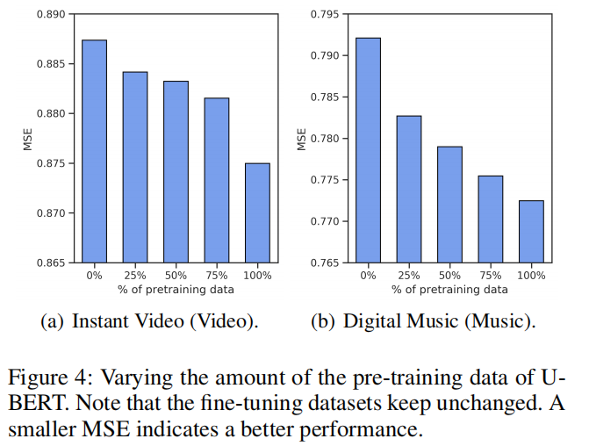
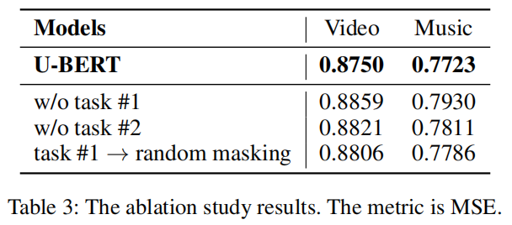
Method
Chongqing University of Technology
ATAI
Advanced Technique of Artificial Intelligence

Slide 15
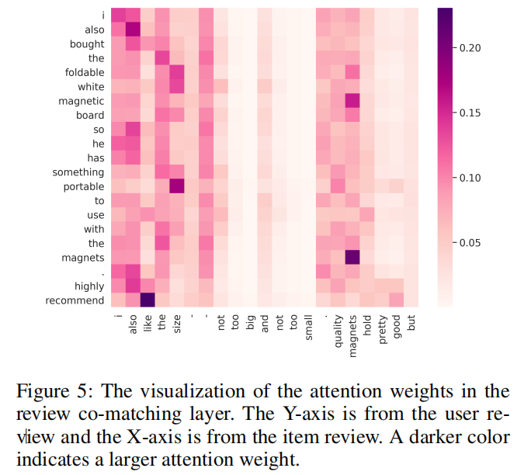
Method
Chongqing University of Technology
ATAI
Advanced Technique of Artificial Intelligence

Slide 16
Chongqing University of Technology
ATAI
Advanced Technique of Artificial Intelligence
Chongqing University of Technology
Thank you!

